Slide 1
The taxation and pricing of heated tobacco products (HTPs)
Ce Shang, Medical Oncology, Department of Internal Medicine, OSUMC
Estelle Dauchy, Campaign for Tobacco Free Kids
TOPS, May 27 2021

Slide 2
Acknowledgement & Disclosure Statement
This is a joint work with Dr. Estelle Dauchy
Ce Shang was funded by the OSU Center for Tobacco Research and Oklahoma Tobacco Settlement of Endowment Trust (TSET).
Estelle Dauchy and data collection are funded by Campaign for Tobacco Free Kids (CTFK).
No financial disclosures or conflict of interest to report
Preliminary results!

Slide 3
Overview
Section 1: A snapshot of the current status of HTP taxes and prices
Tax data Interactive map
Section 2: How HTP taxes are passed to prices
Inform whether taxes on HTPs can be an effective tool to regulate tobacco use

Slide 4
Heated tobacco products (HTPs)
Tobacco heating systems that heat tobacco-filled sticks (processed tobacco leaf) to generate nicotine-containing aerosol
Most common brand -IQOS was invented by the Philip Morris International (PMI) and first introduced in Japan in 2014
There are other HTP brands such as GLO and Ploom
PMI Investor’s Relations Report published in 2021 shows that HTPs are sold or manufactured in at least 64 countries
Profit margins of IQOS are higher compared to cigarettes
HTP devices and heatsticks are authorized for sales in the US market

Slide 5
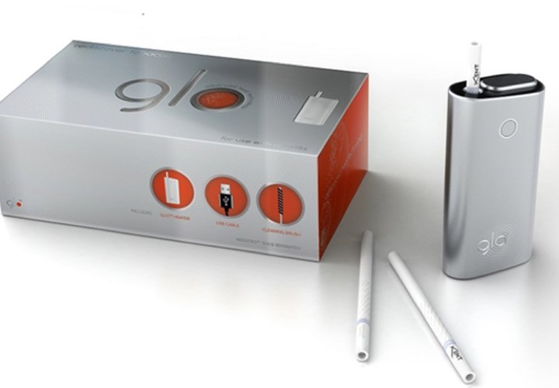
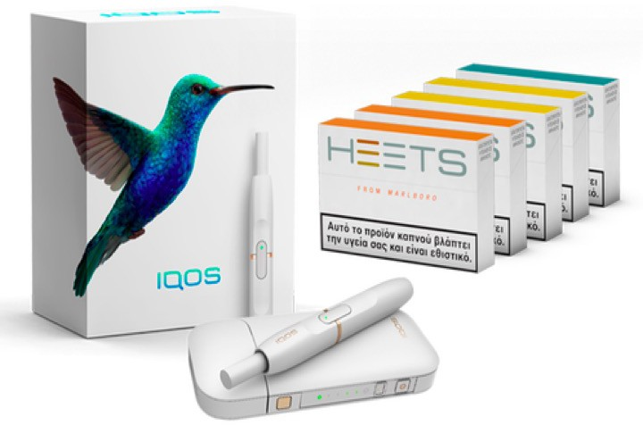
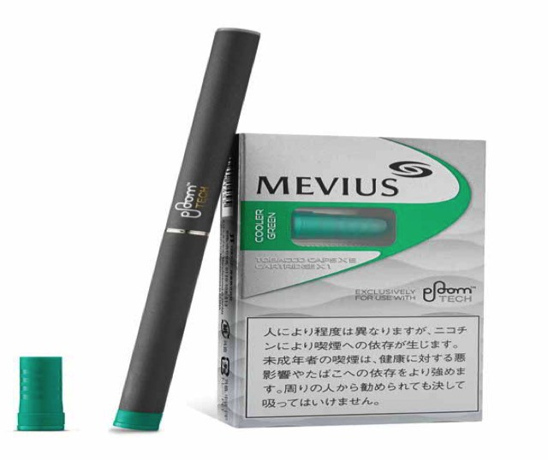
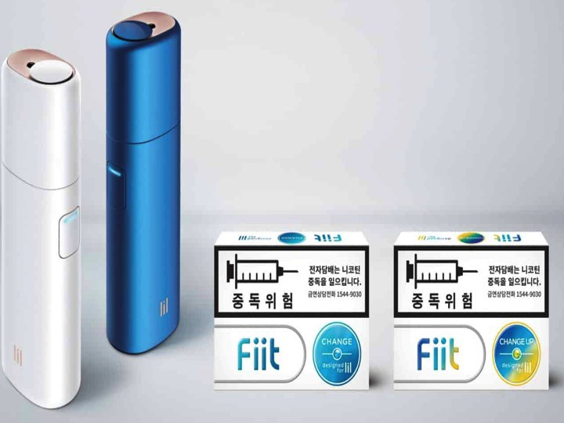
Examples
PMI: IQOS (e.g., Marlboro HEET sticks)
BAT: GLO (e.g., Kent sticks)
JTI: PLOOM TECH (e.g., Mevius)
pods)
KT&G (Korea): Lil (e.g., fiit sticks)

Slide 6
The public health impact of HTPs
HTPs are relatively new and more research is needed to understand their short- and long- term impacts
Nicotine is highly addictive & HTPs may contain some harmful ingredients (Simonavicius et al. 2019)
Populations (﻿Ratajczak et al. 2020; Kopa&﻿Pawliczak 2020)
To prevent tobacco use among youth, young adults, & pregnant women (HTPs are popular among young adults)
Existing smokers: Fully switching to HTPs reduce exposure to harmful chemicals. Introduction to Japan reduced cigarette sales. (Stoklosa et al. 2018)
On July 7, 2020, the US FDA authorized IQOS to be marketed as modified risk tobacco products

Slide 7
Heated Tobacco Products (HTPs): Market Value
Data source : Euromonitor International

Slide 8
HTP excise taxation
According to the model of taxing cigarettes, taxing HTPs could be effective to reduce HTP consumption, particularly among young people
Taxes could also bring tax revenues ~ popular policy tool
HTP taxation is the most covered regulatory policy by news media in Korea (Jun et al. 2021)
Challenges
How to design HTP taxes to balance harm-inducing and harm-reducing use of HTPs. For example, Connecticut explicitly adopts a guideline to tax products that the FDA allows to be marketed as modified risk tobacco products such as IQOS at half the cigarette tax rate.
HTPs are not less expensive than cigarettes (Liber 2018)
Manufacturers are also cigarette companies and may strategize the pricing of HTPs and cigarettes to maximize profits

Slide 9
HTP excise taxation policy scan
Where do we stand in taxing HTPs?
What are the magnitudes of HTP taxes and prices?
How are HTP taxes compared to cigarette taxes?
CTFK’s interactive Tax Map on HTPs and Cigarette Taxation & Prices (database available) covers 61 countries + 13 Canadian Provinces.
Includes (for both products): Tax Rates, Tax burdens, Tax policy descriptions, price information of PMI products, and more.
https://www.tobaccofreekids.org/what-we-do/global/taxation-price/staging-tax-gap

Slide 10
HTP in the tax code: differ by countries
Classification in Tax Code / Excise Tax Code
New Category
36 countries + 1 Canadian province
For instance: “tobacco products that are heated but not combusted during use”
Included in an existing category and taxed accordingly
17 countries
For instance: “other smoking products”, “pipe tobacco”, “smokeless tobacco”
As of Jan 2021, the majority of countries have included a separate category for heated tobacco products
Act of Jan 2021, the tax rate is positive in all countries covered that sell or manufacture HTPs

Slide 11
Taxing Devices?
Some countries also apply an excise tax on devices / tools (when they do, generally for any electronic devices used either with E-cigarettes or heated tobacco)
In the 61 countries covered, only a few tax devices / tools:
Russia (devices), Saudi Arabia, the United Arab Emirates (both devices and tools)

Slide 12
HTP tax structure (bases)
Excise tax system / structure and base
Specific (e.g., quantity-based): 49 countries
Based on weight (kilograms): 38 countries
Based on the number of sticks: 11 countries
Ad-valorem (i.e., value-based) excise: 4 countries
Based on the “suggested retail price” (1): Dominican Republic
Based on the retail sales price (1): Switzerland
Based on “excise price” or “pre-tax price” (2): countries (UAE, Saudi Arabia)
Mixed: 10 countries
Specific tax + Ad-valorem as % of excise tax value that applies on cigarettes (4 countries): Serbia, Italy, Montenegro, Serbia, South Africa
Specific tax + ad-valorem tax based the retail sales price (6): Spain, Portugal, Luxembourg, Israel, Germany, Belgium

Slide 13
HTP and cigarette prices of a 20-stick pack
Source: CTFK’s Interactive Tax Maps for HTPs and Cigarettes
*Calculations based on equivalent cigarettes and comparable HTUs: PMI’s Marlboro Red and HEETS. Conversions to Purchasing Power Parity (PPP) based on IMF’s World Economic Indicators (2020).

Slide 14
Tax burden (% of excise taxes among retail sales prices )
What is it? As an example, tax burden on cigarettes in Bulgaria, 2020:
Retail Sales Price: €5.7
Excise Tax Burden: 63.2% of RSP
Excise Tax:
€4.03

Slide 15
Tax burden gap (differential taxes on differential products)
For example: in Bulgaria 2020 tax gap is 38.4%
Retail Sales Price: €5.7
Excise Tax Burden: 24.5% of RSP
Excise Tax Burden: 63.2% of RSP
Excise Tax:
€4.03
Excise Tax:
€4.03
Excise Tax:
€1.42

Slide 16
Tax burden on cigarettes is higher than on HTPs
Source: CTFK’s Interactive Tax Maps for HTPs and Cigarettes
*Calculations based on equivalent cigarettes and comparable HTUs: PMI’s Marlboro Red and HEETS. Conversions to Purchasing Power Parity (PPP) based on IMF’s World Economic Outlook Indicators (2020).

Slide 17
Difference in tax burdens across countries
Source: CTFK’s Interactive Tax Maps for HTPs and Cigarettes
*Calculations based on equivalent cigarettes and comparable HTUs: PMI’s Marlboro Red and HEETS. Conversions to Purchasing Power Parity (PPP) based on IMF’s World Economic Outlook Indicators (2020).

Slide 18
Summary: HTP vs. Cigarette taxes
HTP price per pack is similar to cigarette price per pack
The excise tax on HTPs ($2) is lower than that on cigarettes ($4.6)
Cigarette taxes are twice as large as HTP taxes
Tax burden on HTPs (25%) is lower than that on cigarettes (50%)
Cigarette tax burden is twice as large as HTP tax burden
Different tax bases : ad valorem vs. specific taxes
Within specific taxes: sticks vs. weight
Within ad valorem taxes: retail prices vs. other values
Devices are rarely taxed
Data source: CTFK’s Interactive Tax Maps for HTPs and Cigarettes

Slide 19
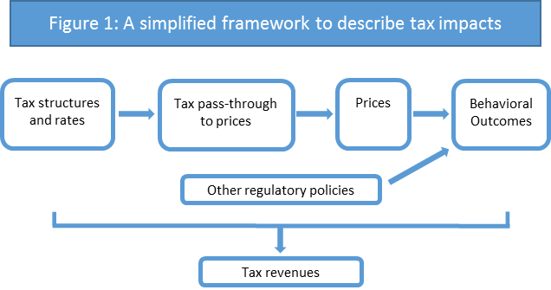
Section 2
Question: How are HTP taxes passed to prices ?
Inform whether taxes on HTPs can be an effective tool to regulate tobacco use and raise tax revenues
Prices mediate the effects of tax structures and rates in influencing behavioral outcomes and other consequences.
Tax ($1) pass-through to prices
Under-shifted <$1 increase
Fully-shifted =$1 increase
Over-shifted >$1 increase

Slide 20
Data
Outcome variables:
HTP (IQOS) prices & Cigarette (Marlboro) prices per pack of 20 sticks, PPP adjusted
Explanatory variables:
HTP and cigarette taxes per pack of 20 sticks, PPP adjusted
Panel Data: 61 countries since the implementation of HTP taxes (2014-2020) ~ cross-country comparison
Controls: income control (GDP per capita)

Slide 21
Summary Statistics
N=137 | Mean (SD)
HTP prices | 7.33 (1.97)
Cigarette prices | 8.1 (3)
HTP excise (total) specific taxes ad valorem taxes | 1.44 (1.22) 0.98 (0.9) 0.46 (1.06)
Cigarette excise (total) specific taxes ad valorem taxes | 4.39 (1.88) 2.66 (1.89) 1.73 (1.42)
Ln (GDP/capita) | 4.69 (2)
Cigarette taxes are about twice larger than HTP taxes
Cigarette and HTP prices are similar (the difference is about $1)
Specific taxes are about twice larger than ad valorem taxes
Trends:
Cigarette prices increase over time
HTP prices remain stable over time

Slide 22
Empirical Approach
Methods
Difference-in-difference (two-way fixed effects)
Control for country fixed effects and year fixed effects
Seemingly-unrelated regressions (SURs) to examine tax pass-through rates in a system of HTPs and cigarettes (Blackwell 2005) ~ considering two products in the same market
Throughout the regressions, standard errors are clustered at the country level
Values are converted to PPP

Slide 23
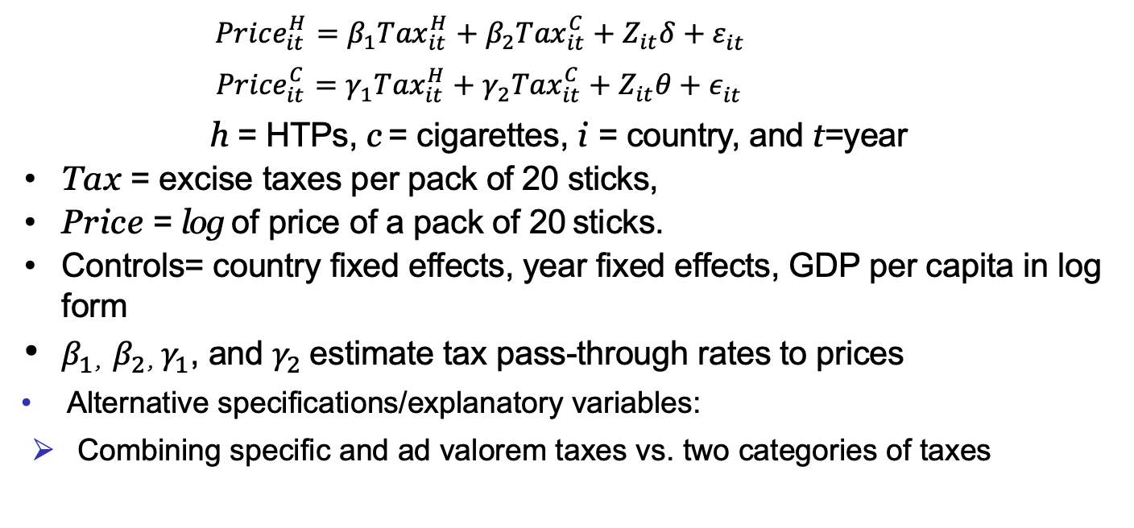
Empirical Approach- continued
$${Price}_{it}^{H}={β_{1}Tax}_{it}^{H}+{β_{2}Tax}_{it}^{C}+{Z_{it}δ+ε}_{it}^{}$$
$${Price}_{it}^{C}={γ_{1}Tax}_{it}^{H}+{γ_{2}Tax}_{it}^{C}+{Z_{it}θ+ε}_{it}^{}$$
h = HTPs, c = cigarettes, i = country, and t=year
Tax = excise taxes per pack of 20 sticks,
Price = log of price of a pack of 20 sticks.
Controls= country fixed effects, year fixed effects, GDP per capita in log form
$β_{1}$, $β_{2}$, $γ_{1}$, and $γ_{2}$estimate tax pass-through rates to prices
Alternative specifications/explanatory variables:
Combining specific and ad valorem taxes vs. two categories of taxes

Slide 24
Results: Tax Pass-through Rates to Prices
N=137 | HTP Price | Cig. Price | HTP Price | Cig. Price
HTP excise taxes (total) | 0.16** (0.07) | 0.03 (0.03) | -- | --
Cig. Excise taxes (total) | 0.19 (0.18) | 1.53*** (0.07) | -- | --
HTP specific taxes | -- | -- | 0.5 (0.23) | -0.2** (0.08)
HTP ad valorem taxes | -- | -- | 0.77**(0.38) | 0.37*** (0.12)
Cig. specific taxes | -- | -- | 0.48 (0.38) | 0.88*** (0.133)
Cig ad valorem taxes | -- | -- | 1.24***(0.36) | 2.05***(0.13)
GDP/capita | -6.29** (1.18) | 1.21*** (0.46) | -7.38*** (1.21) | 1.8*** (0.43)
R2 | 0.944 | 0.996 | 0.951 | 0.996
Note: ∗ ∗ ∗ p <0.01, ∗ ∗ p <0.05, ∗ p <0.1
Standard errors are clustered at the country levels.
Notes:
Notes:
There are direct excise tax effects:
→ HTP excise taxes are passed thru HTP prices (overall)
Cigarette excise taxes are also passed through cigarette prices overall
The direct excise tax pass thru is much larger for cigarettes than HTPs (9 times larger!!!)
The direct excise tax pass thru is more than unity for cigs.
Impact of ad valorem larger than specific

Slide 25
Sensitivity and additional analyses
Alternative model: regressing price gap on tax burden gap (% difference)
Tax burden gap is not significantly associated with price difference
Event study to test parallel trends ~ the implementation of HTP taxes

Slide 26
Conclusions
Tax pass-through to prices
HTP taxes are under-shifted to prices
$1 taxes→$0.16 increase in prices
Cigarette taxes are over-shifted to cigarette prices
$1 taxes→$1.53 increase in prices
Specific HTP taxes are larger than ad valorem taxes but ad valorem taxes are passed to prices at a greater degree than specific taxes
This may be due to most specific taxes are levied on weight not on sticks
Manufacturers reap a higher profit margin on HTPs than on cigarettes and thus have more room to offset taxes or under-shift taxes to prices
Room to increase HTP taxes and raise tax revenues but impact on prices may be limited
Policymakers need to consider HTP and cigarette taxes jointly
It is challenging to create economic incentive for switching from cigarettes to HTPs using low taxes on HTPs.
Increasing cigarette taxes may work better

Slide 27
Limitations and next steps
Limitations:
We use only prices of PMI products (cigarettes and HTPs)
Did not control for other HTP and tobacco regulatory policies
Limited years of data due to the relative novelty of HTPs
Did not consider the influences of E-cigarettes and other tobacco
Did not disentangle the impacts of different tax bases, such as weight vs. sticks
Future steps:
Further evaluate the impact of tax bases
Examine the impacts of taxes on HTP & cigarette demand and prevalence
Close look at price responses for younger adults

Slide 28
Questions? Ce.Shang@osumc.edu ce-shang.com Estelle Dauchy edauchy@TobaccoFreeKids.org

